Slide 1
CSE231 – Digital Logic Design
Unsigned and Signed Numbers,
Binary Arithmetic of Signed Numbers,
and
Binary Codes

Slide 2
Unsigned and Signed Binary Numbers

Slide 3
Unsigned and Signed Numbers
10011010
8-bit Binary number.
What is the decimal equivalent of this binary number?

Slide 4
Unsigned and Signed Numbers
b
n
–
1
b
1
b
0
Magnitude
MSB
(a) Unsigned number
b
n
–
1
b
n
–
2
b
1
b
0
Sign
Magnitude
0 denotes
+
1 denotes
–
MSB
(b) Signed number

Slide 5
Unsigned Binary Numbers

Slide 6
Unsigned Binary Numbers
For an n-bit unsigned binary number,
all n bits are used to represent the magnitude of the number.
** Cannot represent negative numbers.

Slide 7
Unsigned Binary Numbers
For an n-bit binary number
    0 <= D <= 2^{n} – 1
  where D = decimal equivalent value
For an 8-bit binary number: 0 <= D <= 2⁸ – 1
  2⁸ = 256
For a 16-bit binary number: 0 <= D <= 2¹⁶ – 1
  2¹⁶ = 65536

Slide 8
Signed Binary Numbers

Slide 9
Signed Binary Numbers
For an n-bit signed binary number,
n-1 bits are used to represent the magnitude of the number;
the leftmost bit (MSB) is, generally, used to indicate the sign of the number.
0 = positive number
1 = negative number

Slide 10
Signed Binary Numbers
Three representations for signed binary numbers:
1. Sign-and-Magnitude
2. One's Complement
3. Two's Complement

Slide 11
Signed Binary Numbers
Sign-and-Magnitude Representation

Slide 12
Sign-and-Magnitude
For an n-bit signed binary number,
  The MSB (leftmost bit) is the sign bit.
  The remaining n-1 bits represent the magnitude.
  - (2^{n-1} - 1) <= D <= + (2^{n-1} – 1)
    Includes a representation for -0 and +0.
The design of arithmetic circuits for sign-and-magnitude binary numbers is difficult.

Slide 13
Sign-and-Magnitude
Example:
What is the Sign-and-Magnitude binary number representation for the following decimal values, using 8 bits:
+ 97
- 68

Slide 14
Sign-and-Magnitude
Example:
Can the following decimal numbers be represented using Sign-and-Magnitude representation and 8 bits?
- 127
+ 128
- 212
+ 255

Slide 15
Signed Binary Numbers
One's Complement Representation

Slide 16
One's Complement
An n-bit positive number (P) is represented in the same way as in the Sign-and-Magnitude representation.
  The sign bit (MSB) = 0.
  The remaining n-1 bits represent the magnitude.

Slide 17
One's Complement
An n-bit negative number (N) is represented using the “One's Complement” of the equivalent positive number (P).
  N' = One's Complement representation for the negative number N.
  N' = (2^{n} – 1) – P
    where P = |N|
  The sign bit (MSB) = 1 for all negative numbers using the One's Complement representation.

Slide 18
One's Complement
Example:
Determine the One's Complement representation for the following negative numbers, using 8 bits:
- 11
- 107
- 74

Slide 19
One's Complement
The One's Complement representation of N can also be determined using the bit-wise complement of P.
  N = n-bit negative number
  P = |N|
  N' = One's Complement representation of N.
  N' = bit-wise complement of P
    i.e. complement P, bit-by-bit.

Slide 20
One's Complement
Example:
Determine the One's Complement representation (using the bit-wise complement) for the following negative numbers, using 8 bits:
- 11
- 107
- 74

Slide 21
One's Complement
For an n-bit signed binary number,
  - (2^{n-1} - 1) <= D <= + (2^{n-1} – 1)
    Includes a representation for -0 and +0.
    Represents an equal number of positive and negative values.

Slide 22
One's Complement
Given a negative number (N), represented using the One's Complement representation (N'), the magnitude of the number (P) can be determined as follows:
P = (2^{n} – 1) – N'
or
P = bit-wise complement of N'

Slide 23
Signed Binary Numbers
Two's Complement Representation

Slide 24
Two's Complement
An n-bit positive number (P) is represented in the same way as in the Sign-and-Magnitude representation.
  The sign bit (MSB) = 0.
  The remaining n-1 bits represent the magnitude.

Slide 25
Two's Complement
An n-bit negative number (N) is represented using the “Two's Complement” of the equivalent positive number (P).
  N* = Two's Complement representation for the negative number N.
  N* = (2^{n}) – P
    where P = |N|
  The sign bit (MSB) = 1 for all negative numbers using the One's Complement representation.

Slide 26
Two's Complement
Example:
Determine the Two's Complement representation for the following negative numbers, using 8 bits:
- 11
- 107
- 74

Slide 27
Two's Complement
The Two's Complement representation is related to the One's Complement representation as follows:
N' = (2^{n} – 1) – P
N* = (2^{n}) – P
N* = N' + 1

Slide 28
Two's Complement
The Two's Complement representation of N can also be determined by adding 1 to the One's Complement representation of N.
  N = n-bit negative number
  P = |N|
  N' = One's Complement representation of N.
    N' = bit-wise complement of P.
  N* = N' + 1

Slide 29
Two's Complement
Example:
Determine the Two's Complement representation (using the One's Complement) for the following negative numbers, using 8 bits:
- 11
- 107
- 74

Slide 30
Two's Complement
For an n-bit signed binary number,
  - (2^{n-1}) <= D <= + (2^{n-1} – 1)
    Includes only one representation for 0.
    Represents an additional negative value.

Slide 31
Two's Complement
Given a negative number (N), represented using the Two's Complement representation (N*), the magnitude of the number (P) can be determined as follows:
P = (2^{n}) – N*
or
P = bit-wise complement of N* + 1

Slide 32
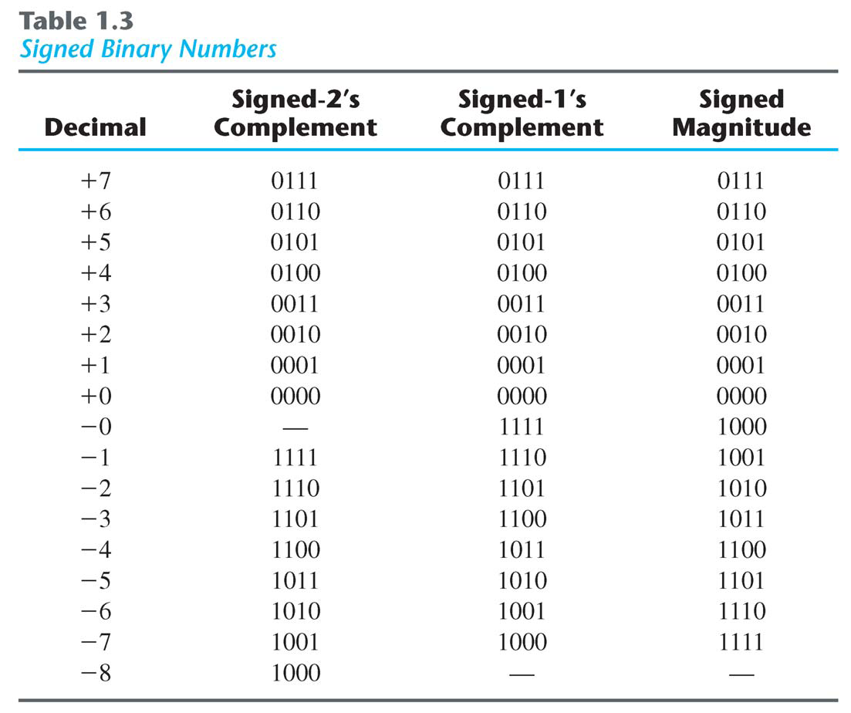
Signed Binary Numbers

Slide 33
Binary Arithmetic
of
Signed Binary Numbers

Slide 34
Two's Complement Addition
Addition of n-bit signed numbers using Two's Complement addition is straightforward.
Addition is carried out in the same way as the addition of n-bit positive numbers.
Carry from the sign position (MSB) is ignored.
Overflow occurs if the correct result (including the sign) cannot be represented in n bits.

Slide 35
Two's Complement Addition
Implement the addition of the following signed numbers using Two's Complement Addition:
32 + 45
-17 + 63
82 + (-29)

Slide 36
Two's Complement Subtraction
A – B = A + (-B)
Subtraction can be implemented using addition.
  Determine the Two's Complement representation for the negative number -B.
  Use Two's Complement Addition to add A and -B.

Slide 37
Two's Complement Subtraction
Implement the subtraction of the following signed numbers using Two's Complement Addition:
32 - 45
-17 - 63
82 - (-29)

Slide 38
One's Complement Addition
Similar to the addition of n-bit numbers using Two's Complement Addition.
Instead of discarding the carry from the sign position (MSB), it must be added to the least significant bit (LSB) of the n-bit sum.
  Referred to as an end-around carry.

Slide 39
One's Complement Addition
Implement the addition of the following signed numbers using One's Complement Addition:
32 + 45
-17 + 63
82 + (-29)

Slide 40
Overflow
General rule for detecting overflow when adding two n-bit numbers using either One's Complement or Two's Complement Addition
  An overflow occurs when the addition of two positive numbers results in a negative value or the addition of two negative numbers results in a positive value.
  Cannot occur when adding a positive number and a negative number.

Slide 41
Binary Codes

Slide 42
Binary Codes
Weighted and Unweighted Codes
  A weighted code is one in which each position in the code has a specific weight
  An unweighted code is one in which the positions in the code do not have a specific weight
A 4-bit weighted code
  Weights: w₃, w₂, w₁, w₀
  Code: a₃a₂a₁a₀
  Decimal: D = a₃ x w₃ + a₂ x w₂ + a₁ x w₁ + a₀ x w₀

Slide 43
Binary Codes
Binary Coded Decimal (BCD)
  4-bit binary number used to represent each decimal digit
  Weighted code: 8-4-2-1
  The binary values 0000 .. 1001 are used to represent the decimal digits 0 .. 9
  The binary values 1010 .. 1111 are not used.
    How do we interpret these unused codes?
  Very different than the binary equivalent of a decimal number.

Slide 44
Binary Codes
2-4-2-1 Code
  Weighted code with w₃ = 2, w₂ = 4, w₁ = 2, w₀ = 1
Excess-3 Code
  Obtained from the 8-4-2-1 (weighted code).
  Add 3 (0011₂) to each of the codes.
2-out-of-5 Code
  Unweighted code
  Exactly 2 of the 5 bits are “1” for each valid code.

Slide 45
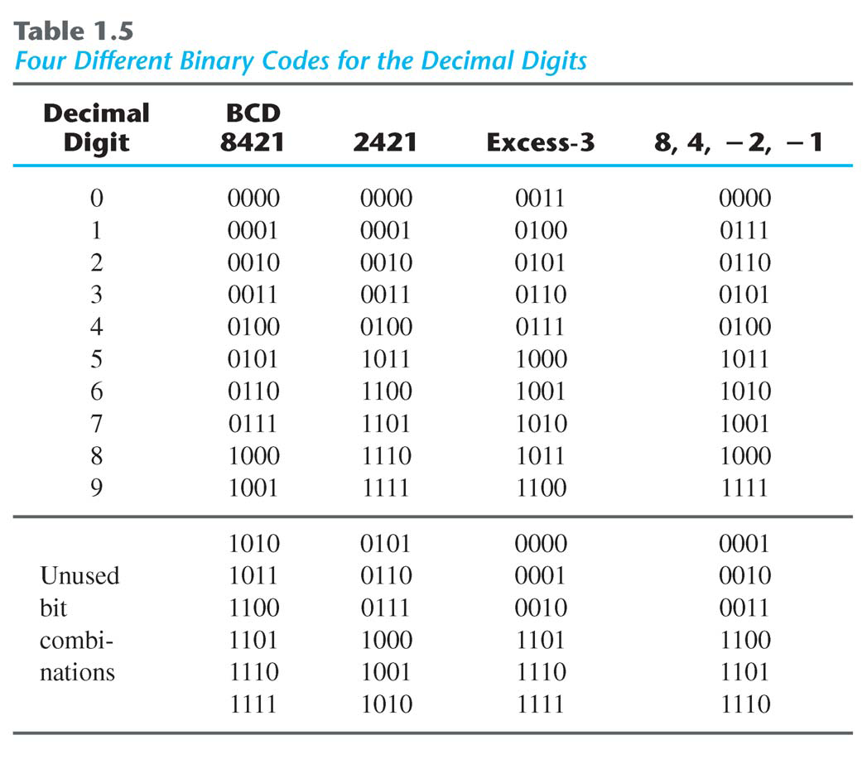
Binary Codes

Slide 46
Binary Codes
Gray Code(s)
  Unweighted code
  Code values for successive decimal digits differ in exactly one bit.
  Example: 2-bit Gray Code
    Decimal Binary Gray Code
    0 00 00
    1 01 01
    2 10 11
    3 11 10

Slide 47
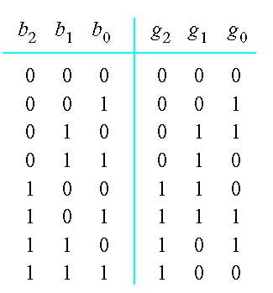
3-bit Gray Code
Decimal
0
1
2
3
4
5
6
7

Slide 48
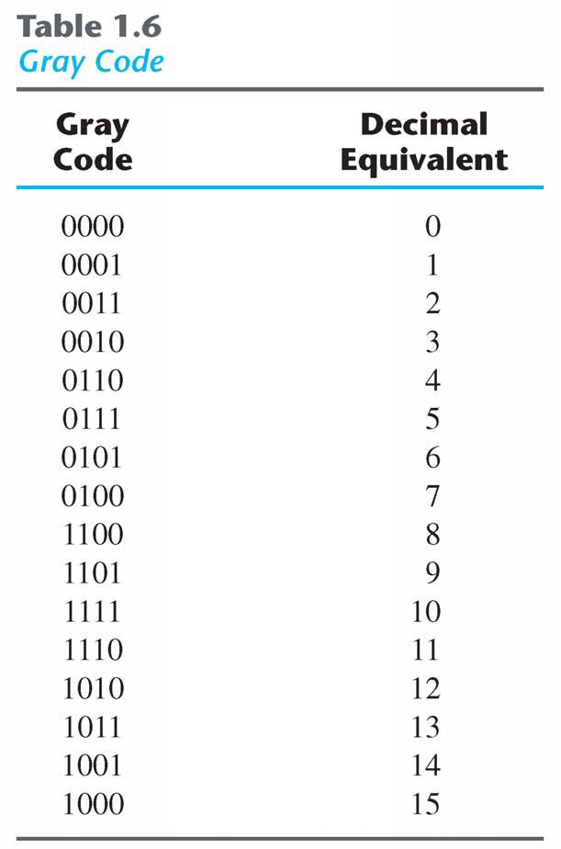
4-bit Gray Code

Slide 49
Binary Code
ASCII Code
  American Standard Code for Information Interchange
  Common code used for the storage and transfer of alphanumeric characters.
  7-bit Weighted Code
    Can represent a total of 128 characters
  Used to represent letters, numbers and other characters (e.g. special control characters)
  Any word or number can be represented (and stored or transferred) using its ASCII Code.

Slide 50
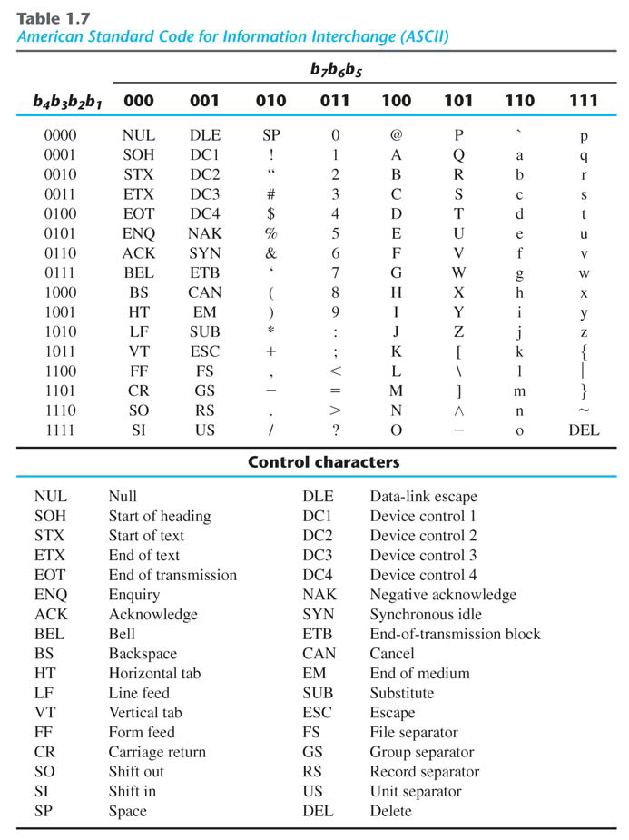
ASCII Code

